Slide 1
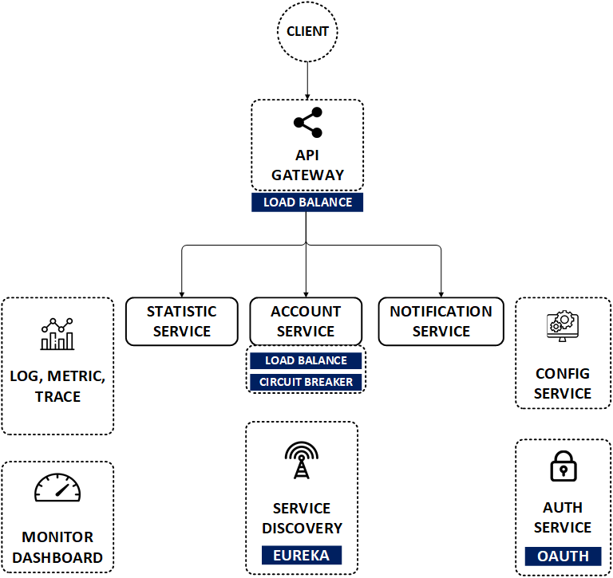

Nâng cấp Micro Apps SpringBoot v.3.x
Port:
9080, 9081
Port: 9082
Port: 9083
www.jmaster.io/course/microservices-with-spring-cloud

